Slide 1
Interpreting Stem and Leaf Plots
Miss L
Year 7

Slide 2
Learning Intentions
Students will be able to
Find the mean, median, mode and range from stem and leaf plots

Slide 3
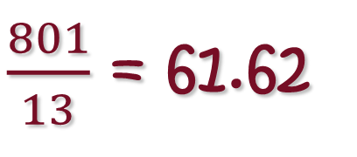
40, 44, 52, 53, 54, 61, 63, 63, 69, 70, 75, 76, 81
24
7
30
Interpreting Stem and Leaf Plots
Date:
40+44+52+53+54+61+63+63+69+70+75+76+81
= 801
EQ – How do I find the mean, median, mode and range from Stem and Leaf Plots?
0 4
2 3 4
1 3 3 9
5|2 = 52
How do I find the Mean?
Stem
Leaf
Step 1: Add all the numbers together
0 5 6
1
4
5
6
7
8
Step 2: Divide the total by the amount of numbers
$\frac{801}{13}$ = 61.62

Slide 4


Slide 5
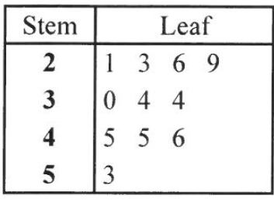
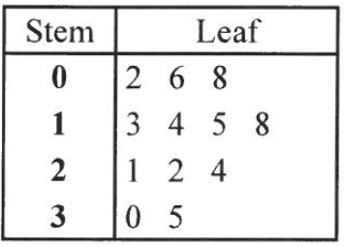
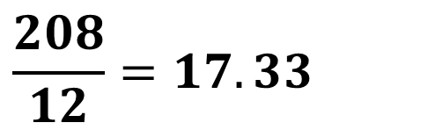
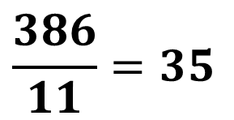
Practice
Find the mean of the following Stem and Leaf Plots
$$\frac{386}{11}=35$$
$$\frac{208}{12}=17.33$$

Slide 6
24
7
30
Interpreting Stem and Leaf Plots
Date:
0 4
EQ – How do I find the mean, median, mode and range from Stem and Leaf Plots?
2 3 4
0 5 6
Stem
Leaf
1 3 3 9
How do I find the Median?
1
Step 1: Find the middle number by counting down until you reach the middle
4
5
6
7
8

Slide 8
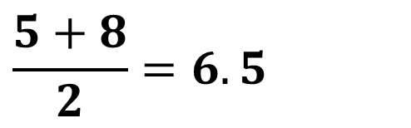
Practice
Find the median of the following Stem and Leaf Plots
$$\frac{5+8}{2}=6.5$$

Slide 9
24
7
30
Interpreting Stem and Leaf Plots
Date:
0 4
EQ – How do I find the mean, median, mode and range from Stem and Leaf Plots?
2 3 4
0 5 6
Stem
Leaf
1 3 3 9
How do I find the Mode?
Step 1: Find the number that occurs the most often
1
4
5
6
7
8
73 occurs the most often

Slide 11


Practice
Find the mode of the following Stem and Leaf Plots
$$34 and 45$$
$$none$$

Slide 12
24
7
30
Interpreting Stem and Leaf Plots
Date:
0 4
EQ – How do I find the mean, median, mode and range from Stem and Leaf Plots?
2 3 4
0 5 6
Stem
Leaf
1 3 3 9
How do I find the Range?
Step 1: Find the smallest number
1
40
4
5
6
7
8
Step 2: Find the largest number
81
Step 3: Largest - smallest
81 – 40 = 41

Slide 14


Practice
Find the range of the following Stem and Leaf Plots
$$53 −21=32$$
$$35 −2=33$$

Slide 15
Task
Complete the worksheet
Find the mean, median, rage and mode for each plot
Complete your summary
Notes:
Guide students through the question.
Option 2: Dot plots handout (Scaffolded for kids who may need extra help)

